Slide 1

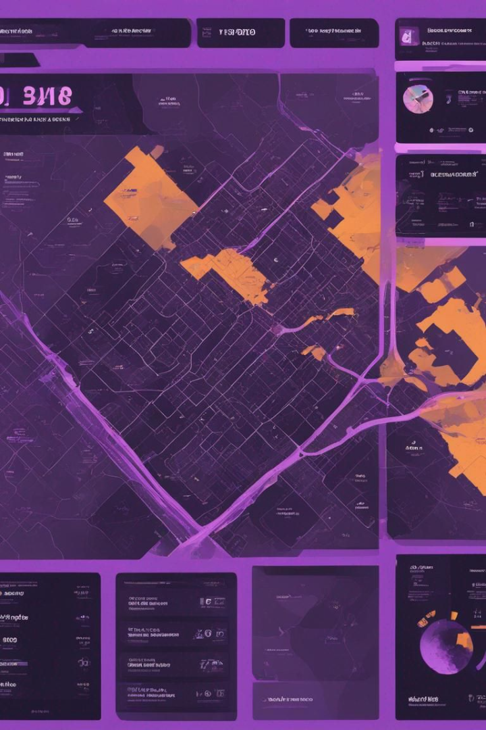
Crime Hotspot Mapping & Behavioural Analysis Interface for Law Enforcement
This revolutionary interface combines crime hotspot mapping with advanced behavioral analysis to provide law enforcement with crucial insights into criminal activities. By leveraging cutting-edge technologies, it offers a comprehensive approach to crime prevention and intervention.

Slide 2

Member Name:
1.Chauhan Jaivik Vikasbhai (Leader)
2.Manani Rashmi Ashokbhai(Member)

Slide 3

Solution Approach
1
Data Collection
Collecting and analyzing historical crime data to identify patterns and hotspots.
2
Behavioral Profiling
Utilizing advanced profiling techniques to understand criminal behavior and trends.
3
Predictive Modeling
Developing predictive models to anticipate and prevent future criminal activities.

Slide 4
Advantages
1
Improved Crime Data Management
2
Crime Hotspot Identification
Visual representation of crime intensities aids in prioritizing high-crime areas. Enables targeted interventions for proactive crime prevention. Facilitates quicker responses to incidents, enhancing public safety.
Streamlines recording, storing, and accessing FIR data. Reduces manual effort and minimizes data inaccuracies or loss. Ensures critical information is readily available for law enforcement agencies.
3
Behavioral Analysis
4
Informed Decision-Making
Provides deeper insights into criminal behavioral patterns. Helps anticipate criminal behavior and identify modus operandi. Allows for the implementation of proactive measures to prevent future crimes.
Access to comprehensive data analytics and visualization tools. Identifies emerging trends and evaluates existing strategies. Allows for adjustments to tactics to address evolving threats effectively.
5
Crime Prevention Strategies
Informs the development of comprehensive crime prevention strategies. Tailors interventions and resource allocation based on crime hotspots and behavioral patterns. Leads to more effective crime prevention measures and improved public safety.

Slide 5
Technologies Used
Frontend technologies
Backend technologies
Geospatial Mapping
Python packages like folium , pymysql Used libraries like MarkerCluster.
HTML5, CSS3, JavaScript, Bootstrap, and Google Maps API for structuring web pages, styling, scripting, responsive design, and integrating maps respectively.
PHP for server-side scripting, MySQL for database management, and Apache as the web server.

Slide 6

Introduction to Crime Hotspot Mapping
Data Visualization
Pattern Recognition
Utilizing heat maps and clustering techniques to represent crime density.
Identifying recurring crime patterns and modus operandi for targeted prevention.
Real-time Monitoring
Enabling real-time monitoring and alerts for law enforcement teams in the field.

Slide 7




Importance of Behavioral Analysis
Predictive Intelligence
Trend Recognition
Advanced Profiling
Strategic Prevention
Unraveling behavioral patterns to forecast criminal activities proactively.
Identifying emerging crime trends and adapting law enforcement strategies accordingly.
Developing detailed criminal profiles to aid investigations and prevention efforts.
Formulating targeted strategies to prevent criminal activities based on behavioral insights.

Slide 8




Benefits of the Interface for Law Enforcement
Effective Resource Utilization
Optimizing law enforcement resources through targeted deployment and timely intervention.
Community Safety
Empowering law enforcement to act preventively, enhancing community safety and trust.
Crime Prevention
Enabling strategic crime prevention measures through predictive and proactive insights.

Slide 9
Implementation of the Solution
24/7 Monitoring
95% Accuracy
Seamless Integration
Constant Vigilance
Predictive Analysis
Integration Capabilities
Continuous monitoring of crime hotspots for timely response and intervention.
Highly accurate predictive analysis to anticipate and prevent criminal activities.
Seamless integration with existing law enforcement systems and processes for enhanced efficiency.

Slide 10

Conclusion and Next Steps
Future Enhancements
Global Implementation
Continuing to develop and refine the interface to address evolving crime patterns.
Exploring opportunities to extend the solution's benefits to law enforcement agencies globally.
Community Engagement
Enhancing community involvement and partnerships for sustainable crime prevention efforts.

